Slide 1
Emerald Resource Guide
Presented by Julie Lin
juliecylin@emeraldinsight.com

Slide 2
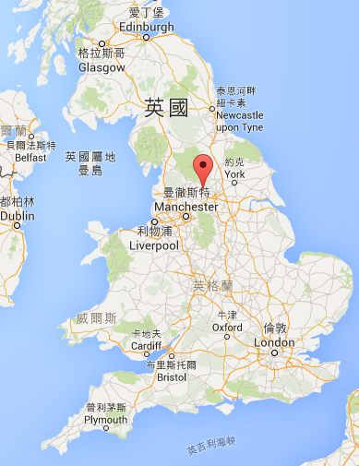

Emerald Group Publishing – Publisher background
Emerald Group Publishing Limited
Founded in 1967 in Bradford, West Yorkshire, UK
Notes:
Emerald Group Publishing - background
Founded by academics, for academics.
Moved into book publishing in 2007.

Slide 3
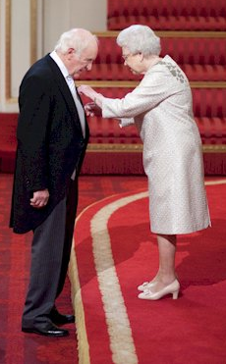
Founded by academics, for academics
Dr Keith Howard OBE*, Phd (Bradford), LLD** (Hon)(Leeds), MSc (Leeds), BSc (Hons) (Leeds)
Chairman – Emerald Global Publishing Group
*OBE: Order of the British Empire
**LLD: Doctor of law (highest degree in law)
Notes:
Emerald Group Publishing - background
Founded by academics, for academics.

Slide 4

Emerald Group Publishing
Founded in 1967, West Yorkshire, United Kingdom by academics for academics.
Over 310 employees
More than 300 journals and 230 book series
Over 21 million Emerald articles were downloaded in 2013 – more than 50,000 a day.
Global offices in Australia, China, Dubai, South Africa Japan, India, Malaysia, Brazil, Mexico, and USA.
Notes:
Emerald Group Publishing - background
Founded by academics, for academics. Moved into book publishing in 2007 after acquisition of books from Elseiver.

Slide 5
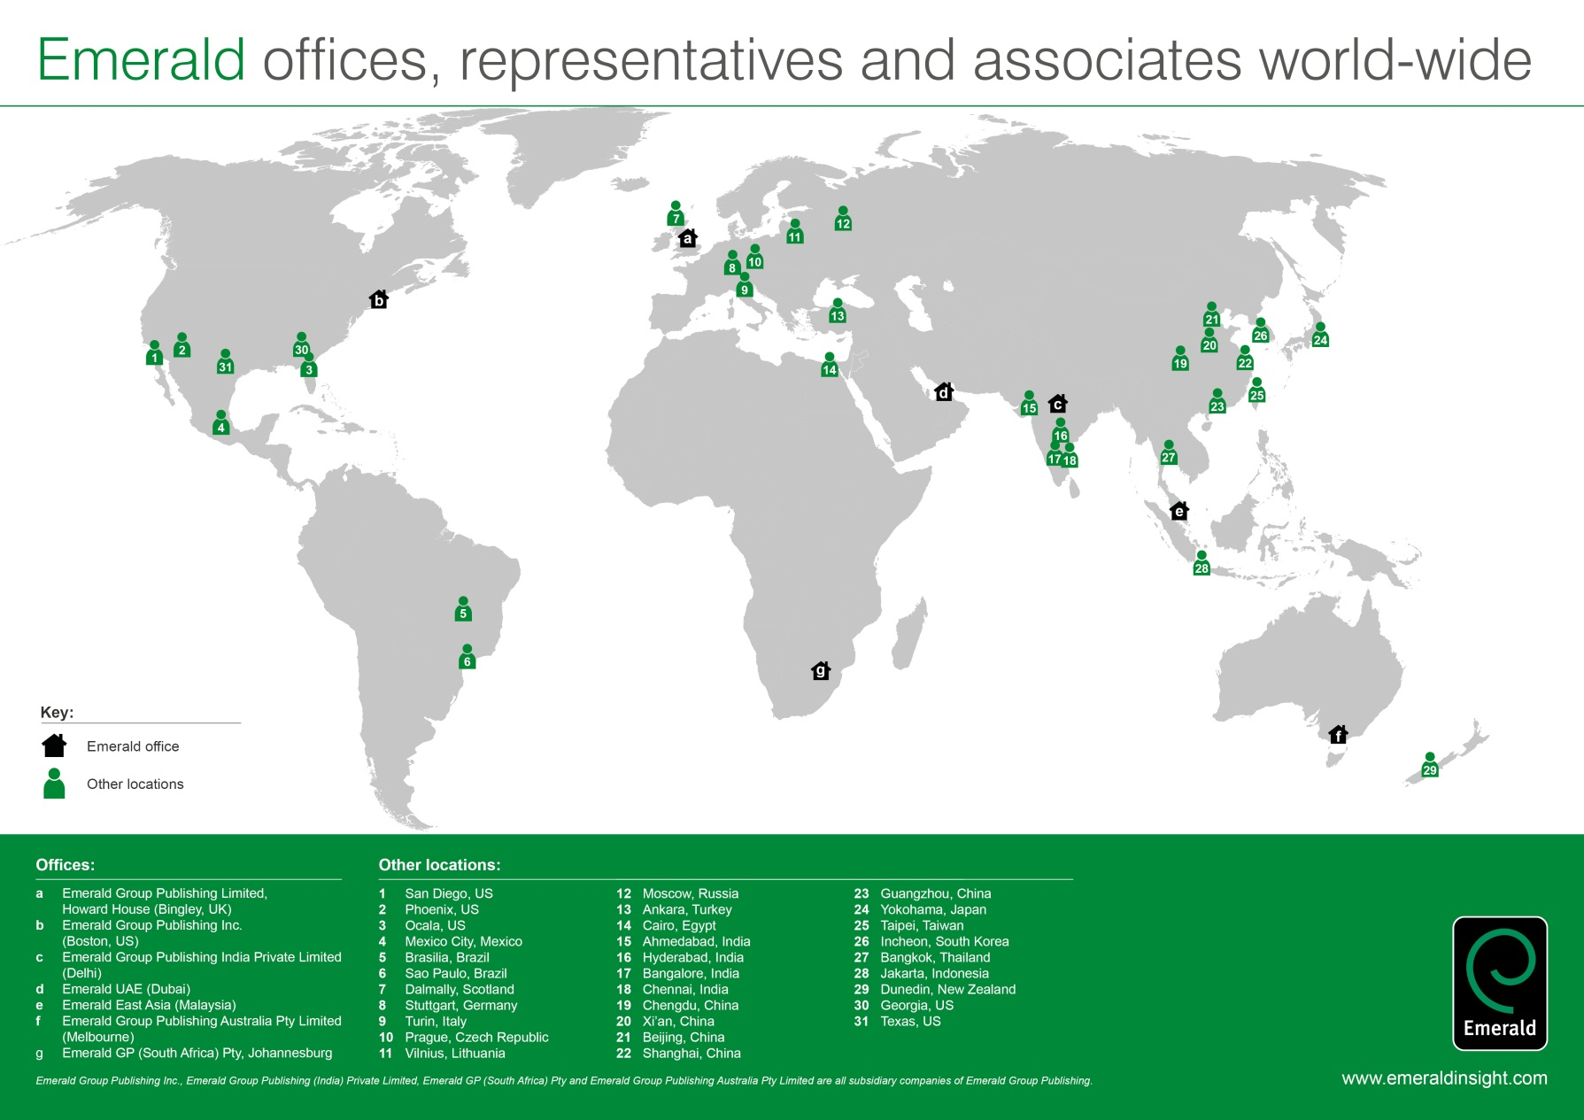
Emerald Group Publishing – company background
Notes:
global company offices all around the world

Slide 6

Financial Times Top 100 Global MBA Rankings
Emerald is proud to say that:
All of the world’s top 100 business schools have contributors to Emerald journals and books.
99 of the 2015 FT top 100 business schools worldwide are Emerald customers.
In 2012 the FT top 100 business schools downloaded Emerald articles 1.25m times, which is an average of nearly 12,500 per school.

Slide 7

How can EmeraldInsight help?
300 Journals
Over 2000 eBooks
13 Subjects
Emerging Market Case Studies

Slide 8









Management eJournals

Slide 9




Specialist eJournals

Slide 10

How to be a modern researcher?
Presented by Julie Lin

Slide 11


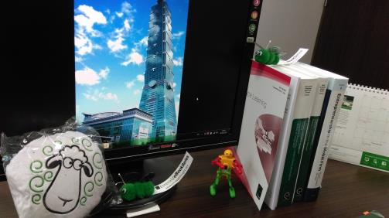
Modern Researcher

Slide 12
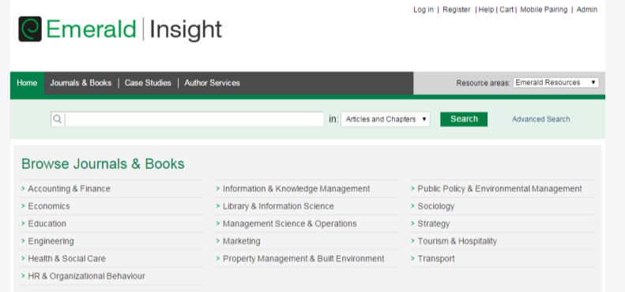
First, A Topic
A topic that you will not fall asleep on
Pick a big theme first

Slide 13
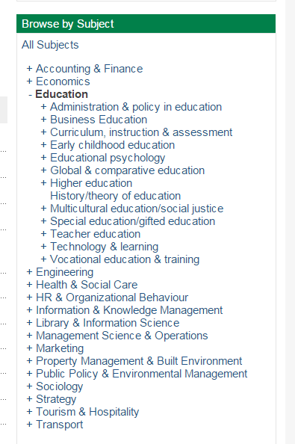
Then a sub-field
Then make it smaller Time Place Topic Issue Problem…

Slide 14
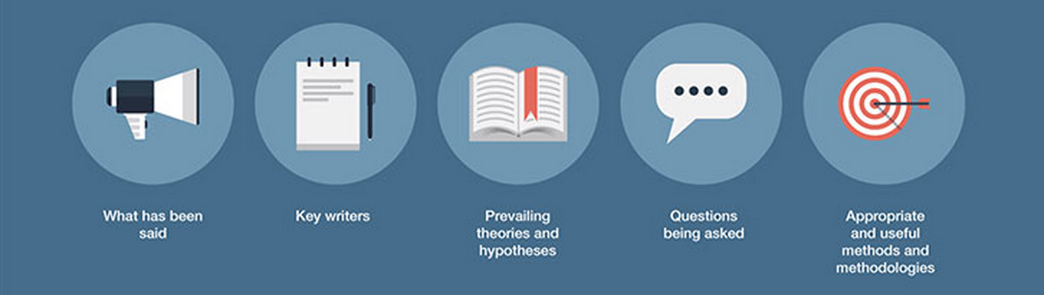
After Topic
Think About These…
Research Question
Theory
Methodology
Then Start With Literature Review
http://www.emeraldgrouppublishing.com/authors/guides/write/literature.htm

Slide 15
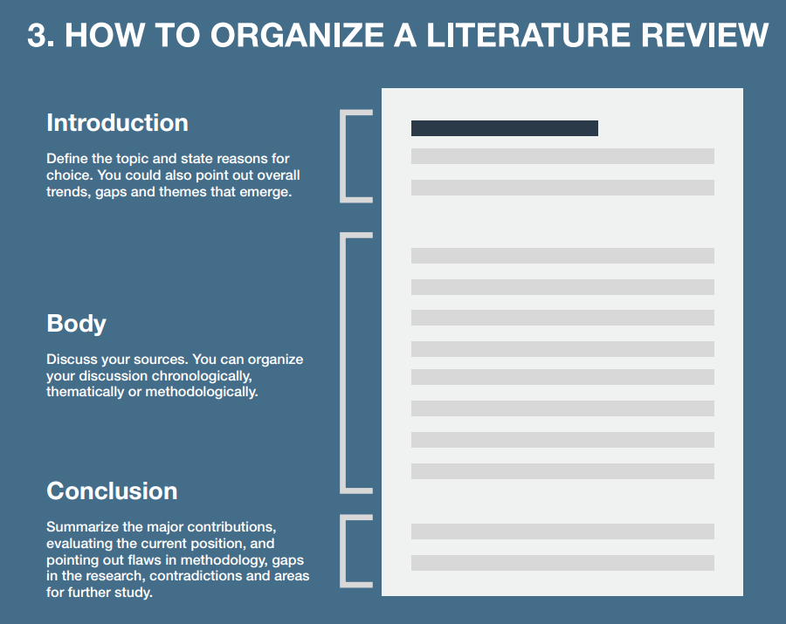

Slide 16
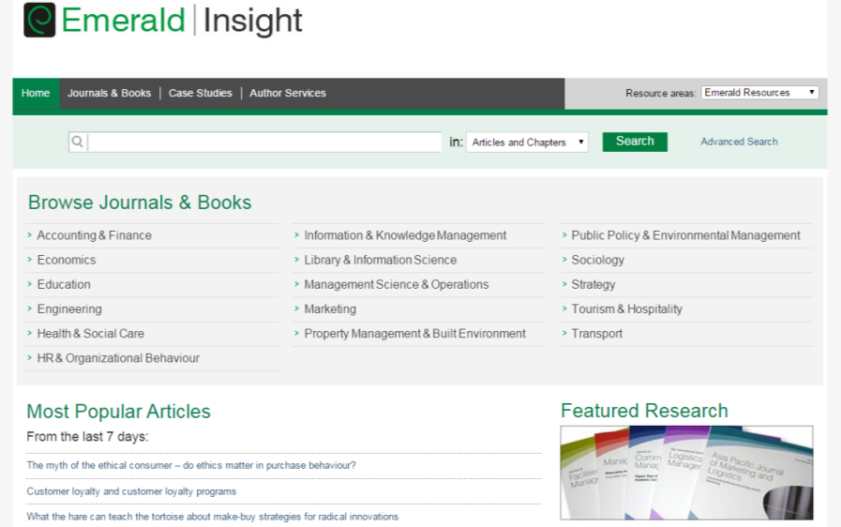
Know Your Tool
1
2
3
4

Slide 17
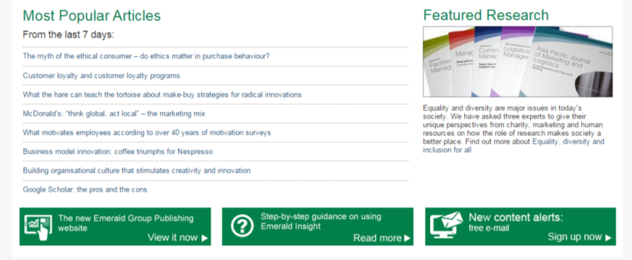
More academic info
Online Guides
Set up notification for subscribed content

Slide 18
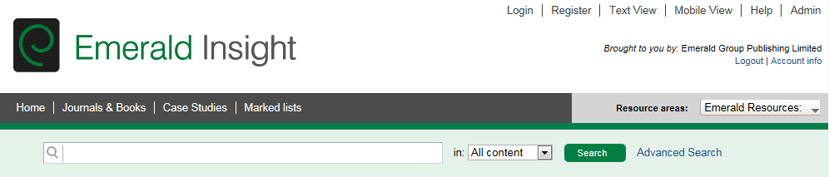
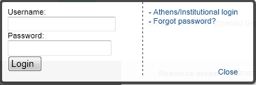
註冊個人化服務
建立屬於您自己的文獻系統
節省您的時間
幫助管理您的文獻資源
輔助您進行學術研究
Once you have registered a profile you will enter your personal username/password here also. REMEMBER institution login first followed by personal login second.

Slide 19
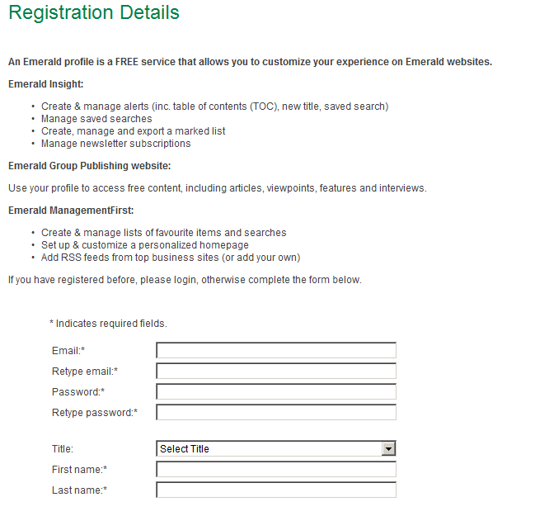
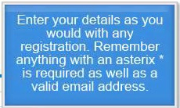
Register-注册个性化服务
註冊個人化服務
常用、正確的郵件地址
Notes:
只用简单注册一下就能获得上述的个性化服务功能，需要特别注意的是邮箱地址一定要填写常用、准确的地址，因为所有的服务都是通过邮件传递的，另外中国地区请勾选“People's Republic of China”。

Slide 20
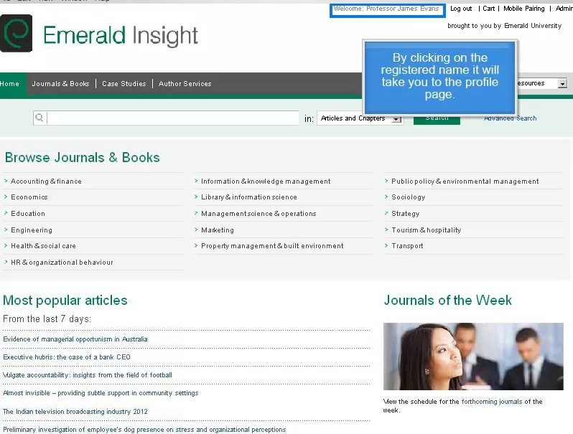

Slide 21
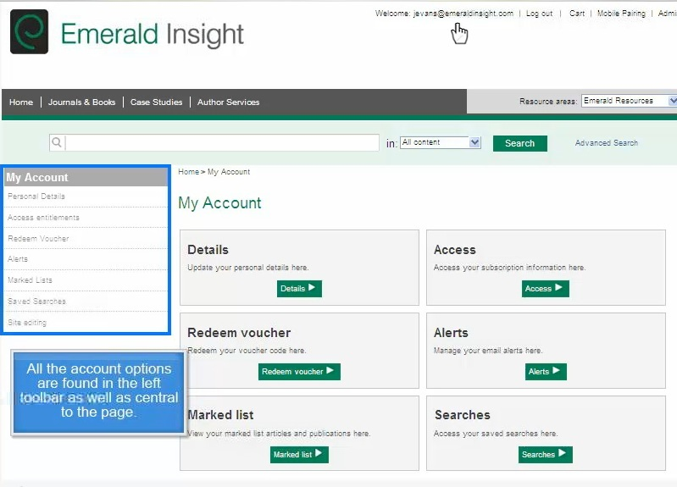
收藏匧
我的記錄

Slide 22
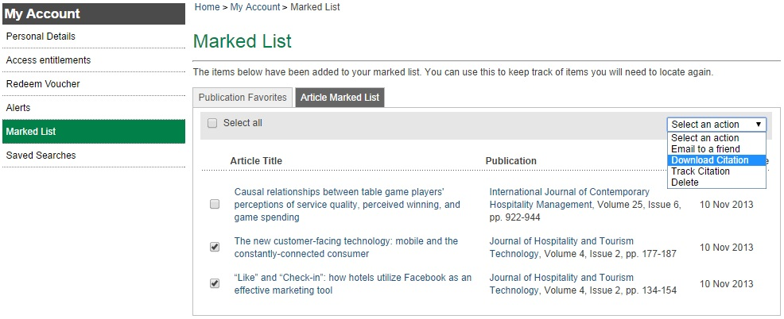
Marked List

Slide 23
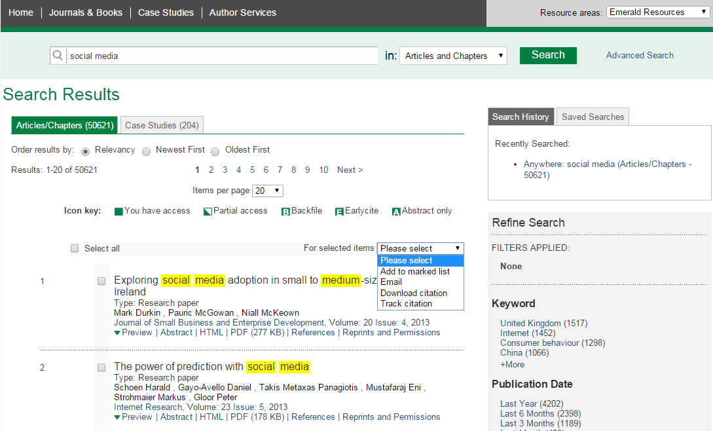
1
3
2
4
4
5

Slide 24
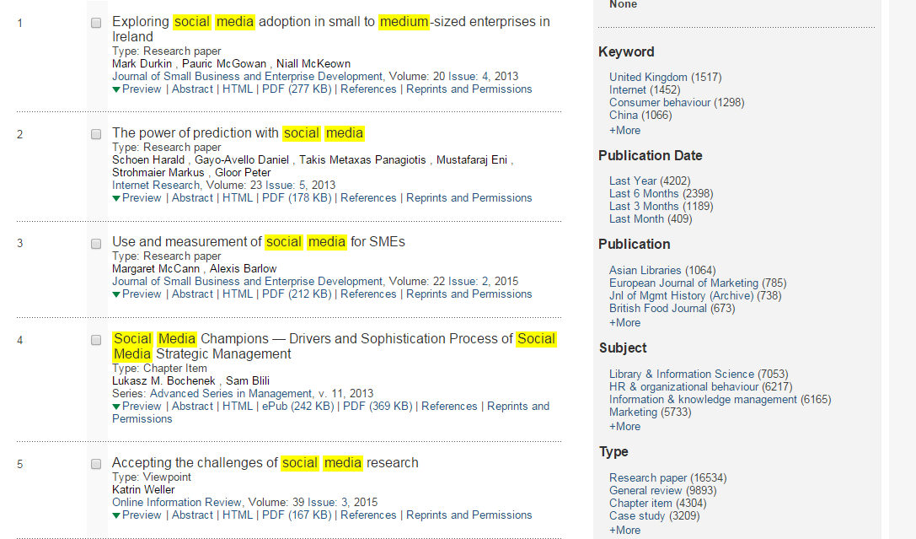
1
3
2

Slide 25
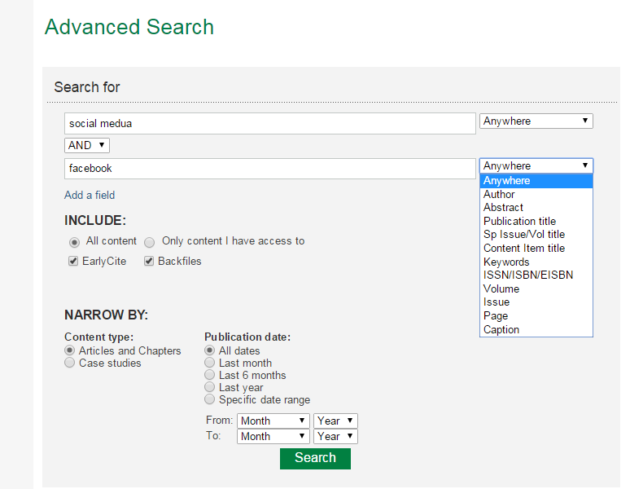
AND
OR
NOT
1
2
3
4
5

Slide 26
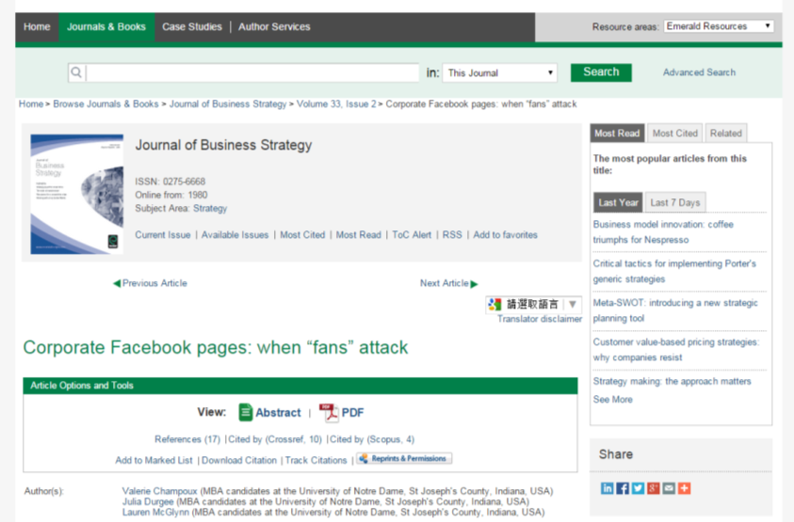
1
2
3
4

Slide 27
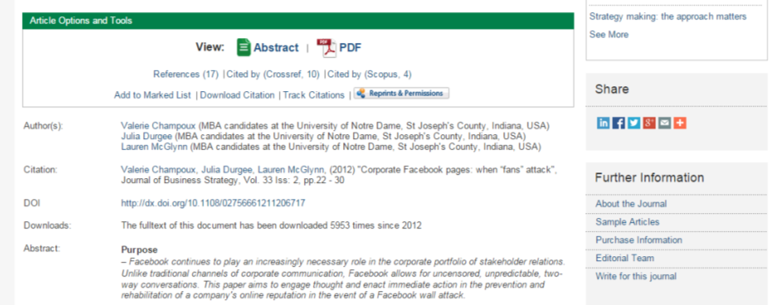
1
2

Slide 28
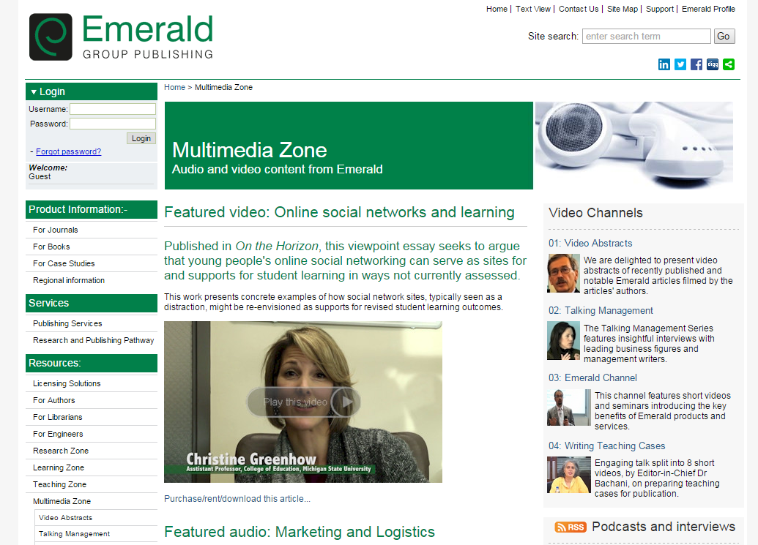
And Keep Learning!

Slide 29

Emerald Insight
  www.emeraldinsight.com
Emerald Group Publishing
  www.emeraldgrouppublishing.com
Let us tell you how to write your First CV!
http://www.emeraldgrouppublishing.com/learning/study_skills/life/job_info.htm

Slide 30

Questions & Answers

Slide 31

Thank you!
Julie Lin
juliecylin@emeraldinsight.com

